Slide 1

Toward Safer Tor Research
Rob Jansen, U.S. Naval Research Laboratory
Rob Jansen, Ph.D.
Computer Security Research Scientist
Center for High Assurance Computer Systems
U.S. Naval Research Laboratory
Workshop on Ethics in Computer Security
European Symposium on Security and Privacy Genoa, Italy
June 10th, 2022

Slide 2
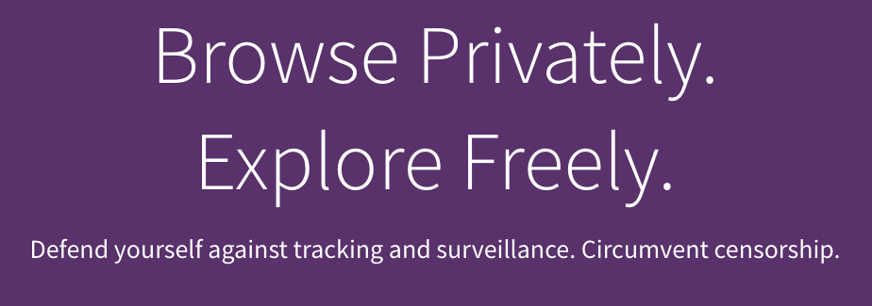




What is Tor?
Anonymous Communication
Separates identification from routing
Provides unlinkable communication
Protects user privacy and safety online
Tor is Popular
~2-8 million daily active users
~7,000 volunteer relays
Transferring ~300 Gbit/s

Slide 3

Why is Tor Used?
Block Trackers
isolate each website you visit so third-party trackers and ads can't follow you
Defend against surveillance
prevent someone watching your connection from knowing what websites you visit
Resist Fingerprinting
all users look the same, making it difficult to be fingerprinted based on browser/device
Browse Freely
free to access sites that your local network may have blocked
https://www.torproject.org

Slide 4
Who Uses Tor?
Normal People | Journalists | Law Enforcement
Activists | Business Executives | Bloggers
Militaries | IT Professionals | Whistleblowers
https://2019.www.torproject.org/about/torusers.html.en

Slide 5
Who Uses Tor?
Normal People | Journalists | Law Enforcement
Activists | Business Executives | Bloggers
Militaries | IT Professionals | Whistleblowers
Protect privacy from marketers and identity thieves
Protect comms from irresponsible corporations
Protect their children online
Research sensitive topics
Skirt surveillance
Circumvent censorship
https://2019.www.torproject.org/about/torusers.html.en

Slide 6
Who Uses Tor?
Normal People | Journalists | Law Enforcement
Activists | Business Executives | Bloggers
Militaries | IT Professionals | Whistleblowers
Online surveillance
Sting operations
Truly anonymous tip lines
https://2019.www.torproject.org/about/torusers.html.en

Slide 7
Who Uses Tor?
Normal People | Journalists | Law Enforcement
Activists | Business Executives | Bloggers
Militaries | IT Professionals | Whistleblowers
Security breach information clearinghouses
Seeing your competition as your market does
Keeping strategies confidential
Accountability
https://2019.www.torproject.org/about/torusers.html.en

Slide 8
Who Uses Tor?
Normal People | Journalists | Law Enforcement
Activists | Business Executives | Bloggers
Militaries | IT Professionals | Whistleblowers
To verify IP based firewall rules
To bypass their own security systems
To access internet resources
To work around ISP network outages
To connect back to deployed services
https://2019.www.torproject.org/about/torusers.html.en

Slide 9
User Safety in Tor
Tor is a Privacy-Preserving Anonymous Communication Network in which
User Safety is of Highest Priority

Slide 10
Outline
Tor Safety Board overview
Research areas relevant to safety
Simulating Tor with Shadow
Measuring Tor with PrivCount
Safe research applications
Ongoing struggles

Slide 11
Outline
Tor Safety Board overview
Research areas relevant to safety
Simulating Tor with Shadow
Measuring Tor with PrivCount
Safe research applications
Ongoing struggles

Slide 12

What is the Tor Research Safety Board?
A group of Tor researchers who want to minimize privacy risks while fostering a better understanding of the Tor network and its users
Main activities of the board:
develop and maintain a set of guidelines that researchers can use to assess the safety of their Tor research
give feedback to researchers who use our guidelines to assess the safety of their planned research
teach program committees about our guidelines, and encourage reviewers to consider research safety when reviewing Tor papers

Slide 13
What is the Tor Research Safety Board?
A group of Tor researchers who want to minimize privacy risks while fostering a better understanding of the Tor network and its users
Main activities of the board:
develop and maintain a set of guidelines that researchers can use to assess the safety of their Tor research
give feedback to researchers who use our guidelines to assess the safety of their planned research
teach program committees about our guidelines, and encourage reviewers to consider research safety when reviewing Tor papers

Slide 14
What the Tor Research Safety Board is NOT
The Safety Board is NOT a replacement for your IRB!
You must still follow your organization’s requirements for IRB
We are not an ethics board
We help you think about how to make your work safer
We do not approve/deny research
We hope your safety analysis will be added to your paper

Slide 15
Tor Research Safety Board Guidelines
Use a test Tor network whenever possible.
It’s safest to only attack yourself / your own traffic.
Only collect data that is safe to make public.
Don’t collect data you don’t need (minimization).
Take reasonable security precautions, e.g. about who has access to your data sets or experimental systems.
Limit the granularity of data (e.g. use bins or add noise).
The benefits should outweigh the risks.
Consider auxiliary data (e.g. third-party data sets) when assessing the risks.
Consider whether the user meant for that data to be private.

Slide 16
Tor Research Safety Board Guidelines
Use a test Tor network whenever possible.
It’s safest to only attack yourself / your own traffic.
Only collect data that is safe to make public.
Don’t collect data you don’t need (minimization).
Limit the granularity of data (e.g. use bins or add noise).

Slide 17
Tor Research Safety Board Guidelines
Use a test Tor network whenever possible.
It’s safest to only attack yourself / your own traffic.
Only collect data that is safe to make public.
Don’t collect data you don’t need (minimization).
Limit the granularity of data (e.g. use bins or add noise).
Take reasonable security precautions, e.g. about who has access to your data sets or experimental systems.

Slide 18
Tor Research Safety Board Guidelines
Use a test Tor network whenever possible.
It’s safest to only attack yourself / your own traffic.
Only collect data that is safe to make public.
Don’t collect data you don’t need (minimization).
Limit the granularity of data (e.g. use bins or add noise).
Take reasonable security precautions, e.g. about who has access to your data sets or experimental systems.
The benefits should outweigh the risks.
Consider auxiliary data (e.g. third-party data sets) when assessing the risks.
Consider whether the user meant for that data to be private.

Slide 19
Questions to Guide Feedback Request
What are you trying to learn, and why is that useful for the world? That is, what are the hoped-for benefits of your experiment?
What exactly is your plan? That is, what are the steps of your experiment, what will you collect, how will you keep it safe, and so on.
What attacks or risks might be introduced or assisted because of your actions or your data sets, and how well do you resolve each of them? Use the “safety guidelines” above to help in the brainstorming and analysis.
Walk us through why the benefits from item 1 outweigh the remaining risks from item 3: why is this plan worthwhile despite the remaining risks?

Slide 20
Questions to Guide Feedback Request
What are you trying to learn, and why is that useful for the world? That is, what are the hoped-for benefits of your experiment?
What exactly is your plan? That is, what are the steps of your experiment, what will you collect, how will you keep it safe, and so on.
What attacks or risks might be introduced or assisted because of your actions or your data sets, and how well do you resolve each of them? Use the “safety guidelines” above to help in the brainstorming and analysis.
Walk us through why the benefits from item 1 outweigh the remaining risks from item 3: why is this plan worthwhile despite the remaining risks?

Slide 21
Questions to Guide Feedback Request
What are you trying to learn, and why is that useful for the world? That is, what are the hoped-for benefits of your experiment?
What exactly is your plan? That is, what are the steps of your experiment, what will you collect, how will you keep it safe, and so on.
What attacks or risks might be introduced or assisted because of your actions or your data sets, and how well do you resolve each of them? Use the “safety guidelines” above to help in the brainstorming and analysis.
Walk us through why the benefits from item 1 outweigh the remaining risks from item 3: why is this plan worthwhile despite the remaining risks?

Slide 22
Questions to Guide Feedback Request
What are you trying to learn, and why is that useful for the world? That is, what are the hoped-for benefits of your experiment?
What exactly is your plan? That is, what are the steps of your experiment, what will you collect, how will you keep it safe, and so on.
What attacks or risks might be introduced or assisted because of your actions or your data sets, and how well do you resolve each of them? Use the “safety guidelines” above to help in the brainstorming and analysis.
Walk us through why the benefits from item 1 outweigh the remaining risks from item 3: why is this plan worthwhile despite the remaining risks?

Slide 23

Submitting your Feedback Request
HotCRP instance: https://safetyboard.torproject.net/submit
Submit, then assigned board reviewers who provide written feedback
~35 submissions in last ~5 years
Examples: https://research.torproject.org/safetyboard/

Slide 24
Outline
Tor Safety Board overview
Research areas relevant to safety
Simulating Tor with Shadow
Measuring Tor with PrivCount
Safe research applications
Ongoing struggles

Slide 25
Test Tor Networks
Completely private test network
100% safe: absolutely no safety or privacy risks
Enables evaluation of attacks that potentially harm Tor or its users:
Website fingerprinting
End-to-end correlation
Other traffic analysis
Denial of service
Protocol attacks
Safety Guideline 1: Use a test Tor network whenever possible

Slide 26
Contributing Research
Co-opting Linux Processes for High-Performance Network Simulation. Rob Jansen, Jim Newsome, and Ryan Wails. USENIX Annual Technical Conference, 2022.
Once is Never Enough: Foundations for Sound Statistical Inference in Tor Network Experimentation. Rob Jansen, Justin Tracey, and Ian Goldberg. USENIX Security, 2021.
High Performance Tor Experimentation from the Magic of Dynamic ELFs. Justin Tracey, Rob Jansen, and Ian Goldberg. CSET, 2018.
Shadow-Bitcoin: Scalable Simulation via Direct Execution of Multi-threaded Applications. Andrew Miller and Rob Jansen. CSET, 2015.
Methodically Modeling the Tor Network. Rob Jansen, Kevin Bauer, Nick Hopper, and Roger Dingledine. CSET 2012.
Shadow: Running Tor in a Box for Accurate and Efficient Experimentation. Rob Jansen and Nicholas Hopper. NDSS, 2012.

Slide 27

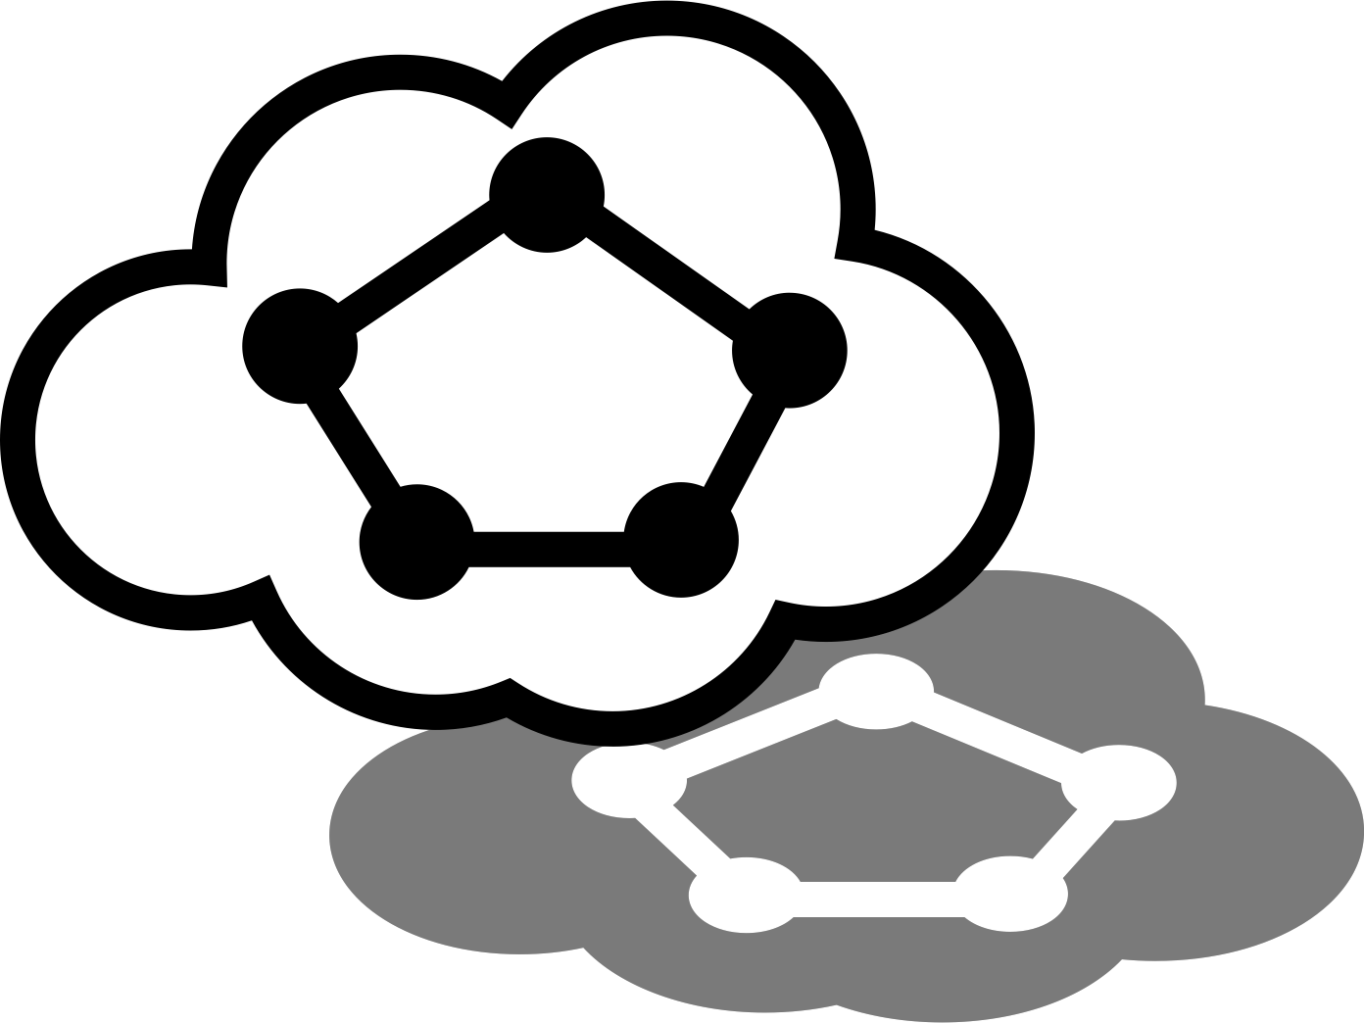
Network Experimentation Requirements
The most important property of test networks:
Controllable: isolate important factors
Replicable: achievable with determinism
Requirements for large distributed systems (e.g., Tor)
Accurate: directly execute system software (not an abstraction)
Scalable: can run studied system at scale
Shadow
Network simulator with above design goals
Open source: https://shadow.github.io
Controllable
Scalable
Replicable
Accurate
Shadow

Slide 28
What is Shadow?
Discrete-event packet-level network simulator
Directly executes apps (e.g., Tor) as standard Linux processes
Intercepts all system calls made by apps and emulates them
Simulates system call behavior and networking
File descriptors (files, sockets, pipes, etc.)
Event notification (poll, epoll, select)
Networking (buffers, protocols incl. TCP/UDP, interfaces)
DNS and routing (latency, bandwidth, etc.)

Slide 29
What is Shadow?
A parallel, discrete-event, packet-level, hybrid network simulator/emulator

Slide 30




Direct Execution
Directly executes applications as standard Linux processes
IPC
control
channels
IPC
control
channels
Applications run as normal, making syscalls, sending packets, etc.

Slide 31
Processes in Linux
Application process (directly executed by Shadow)
Shadow Process
Linux Kernel Syscall API
Linux Kernel
Devices (network interface)
Network

Slide 32
Resolving Library Symbols
Application process executed by Shadow
Shadow process
Linked libraries
Linked libraries
Application Code
Library 1 (e.g. libc)
…
Library N
Shadow Code
Shadow Libraries
Linux Kernel Syscall API
Linux Kernel
Devices (network interface)
Network

Slide 33
Use Shim to Control Process
Inject Shim when executing process
Application Code
Library 1 (e.g. libc)
…
Library N
Shadow Code
Shadow Libraries
Shadow’s injected shim library
Linux Kernel Syscall API
Linux Kernel
Devices (network interface)
Network

Slide 34
Intercepting System Calls
Intercept libcalls (LD_PRELOAD)
Inject Shim when executing process
Application Code
Library 1 (e.g. libc)
…
Library N
Lib 0
Shadow Code
Shadow Libraries
Shadow’s injected shim library
Linux Kernel Syscall API
Linux Kernel
Devices (network interface)
Network

Slide 35
Intercepting System Calls
Intercept libcalls (LD_PRELOAD)
Inject Shim when executing process
Application Code
Library 1 (e.g. libc)
…
Library N
Lib 0
Shadow Code
Shadow Libraries
Shadow’s injected shim library
Linux Kernel Syscall API
Linux Kernel
Intercept syscalls (seccomp)
Devices (network interface)
Network

Slide 36
App-Process to Shadow-Process Communication
Shared memory and semaphores used for IPC
Application Code
Library 1 (e.g. libc)
…
Library N
Lib 0
Shadow Code
Shadow Libraries
Shadow’s injected shim library
Linux Kernel Syscall API
Linux Kernel
Devices (network interface)
Network

Slide 37
Syscall Emulation and Network Simulation
Shadow emulates syscalls while simulating kernel ops (e.g. networking)
Application Code
Library 1 (e.g. libc)
…
Library N
Lib 0
Shadow Code
Shadow Libraries
Shadow’s injected shim library
Linux Kernel Syscall API
Linux Kernel
Intercepted syscalls get sent to Shadow over shared memory
Devices (file system)

Slide 38
Outline
Tor Safety Board overview
Research areas relevant to safety
Simulating Tor with Shadow
Measuring Tor with PrivCount
Safe research applications
Ongoing struggles

Slide 39
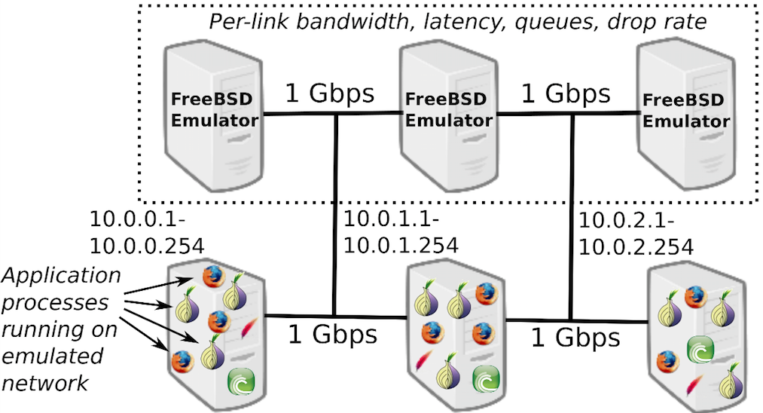
Modeling Tor Networks
Tor research depends on network experimentation tools to:
Evaluate research design changes and trade-offs
Test effects across a range of deployment scenarios and network conditions
Reproduce research results
Shadow:
Network Simulation
Chutney/NetMirage/ExpTor:
Network Emulation

Slide 40

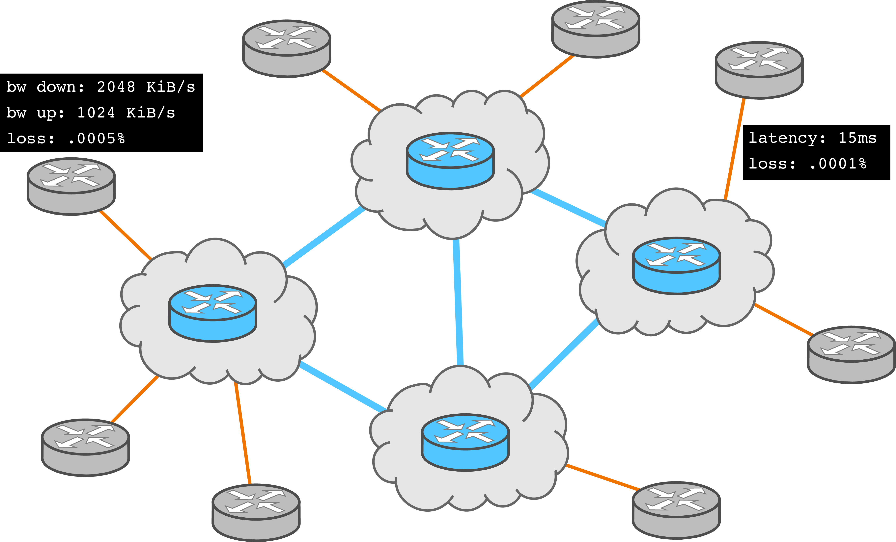
Modeling Tor Networks
How should we construct a private Tor network from scratch?
How many clients? How many servers?
What is the behavior? Download a file?
How many relays?
Entries, middles, exit positions
How to sample relays?
What are the node characteristics?
location, bandwidth, rate limits
We develop methods and tools:
To safely measure Tor
To generate realistic traffic in test networks
To construct realistic private Tor nets

Slide 41
Contributing Research
On the Accuracy of Tor Bandwidth Estimation. Rob Jansen and Aaron Johnson. PAM, 2021.
Understanding Tor Usage with Privacy-Preserving Measurement. Akshaya Mani, T Wilson-Brown, Rob Jansen, Aaron Johnson, and Micah Sherr. IMC, 2018.
Privacy-Preserving Dynamic Learning of Tor Network Traffic. Rob Jansen, Mathew Traudt, and Nicholas Hopper. CCS 2018.
Safely Measuring Tor. Rob Jansen and Aaron Johnson. CCS 2016.

Slide 42
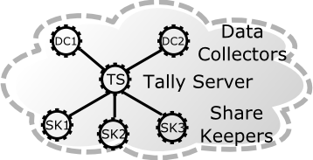
PrivCount Measurement System
PrivCount: a privacy-preserving counting system
Designed to safely collect useful Tor statistics
Based on the PrivEx secret sharing protocol [CCS’14]
PrivCount security goals:
Forward privacy: adversary cannot learn state of measurement before time of compromise
Secure aggregation across all measurement nodes
Measurement results are differentially private to protect user actions

Slide 43
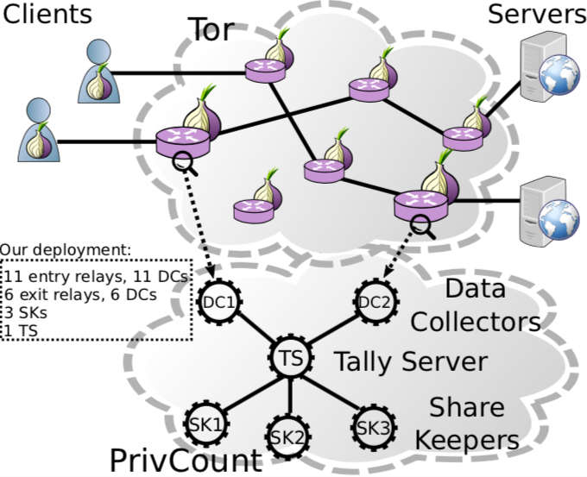
Deploying PrivCount on the Public Tor Network

Slide 44
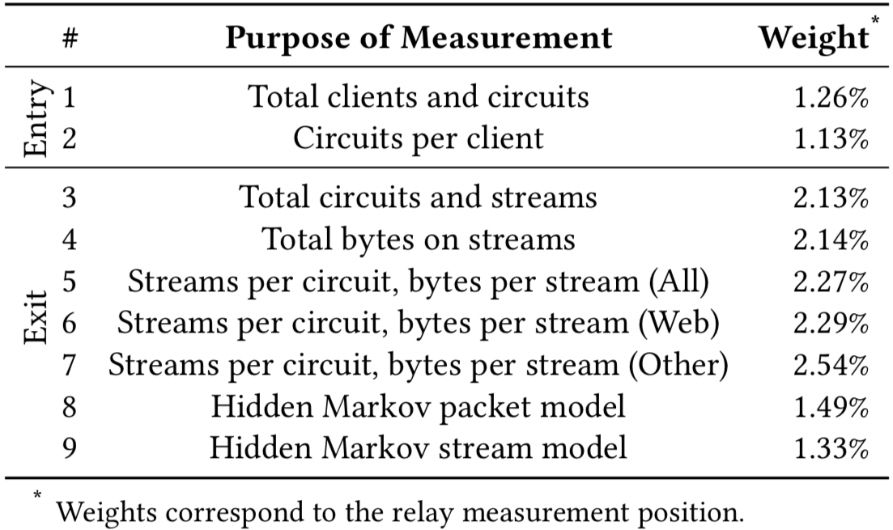
Deploying PrivCount on the Public Tor Network

Slide 45
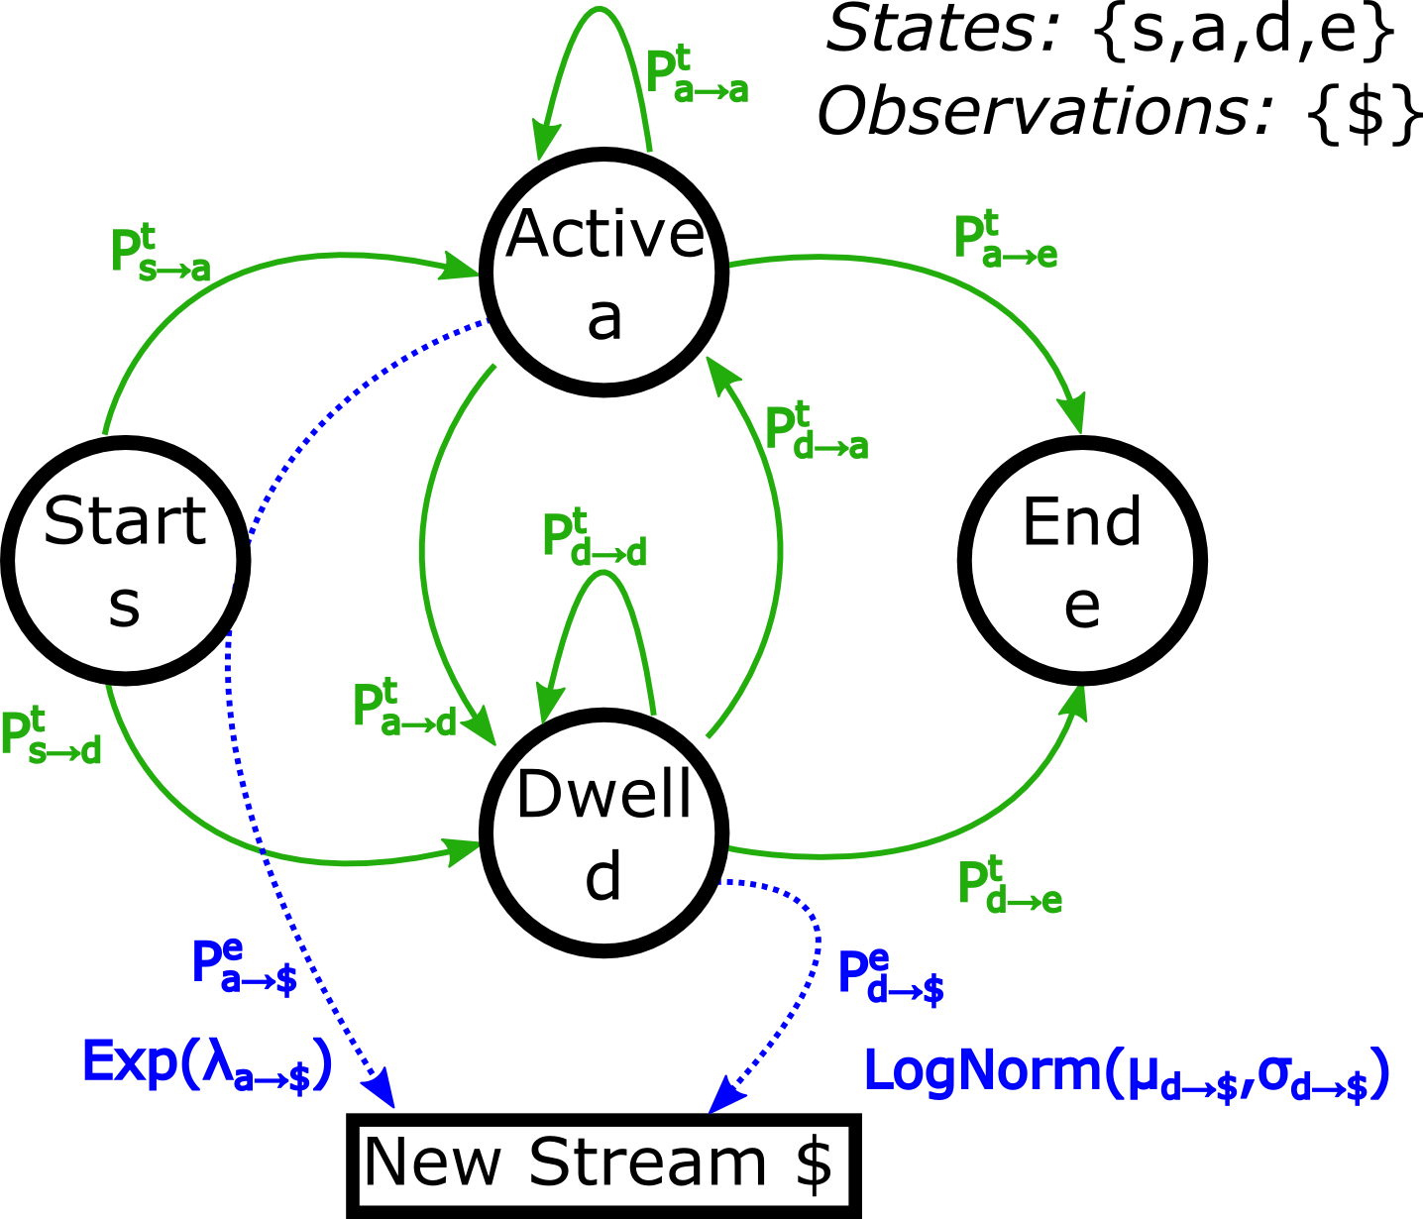
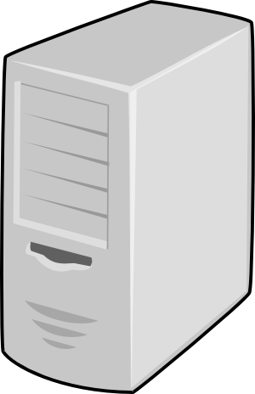
Hidden Markov Modeling of Traffic
Use exit relay observations and PrivCount to safely learn HMM stream and packet models of live Tor traffic
Exits can observe:
Stream model events
Circuit opened, stream created, circuit closed
Packet model events
Stream opened, packet transferred (directional), stream closed
Both models
Inter-event timing (relative time since previous observed event)
Treat Markov model transition probabilities as PrivCount counters

Slide 46
Realistic Private Tor Networks
Shadow:
Directly executes Tor and other apps
Use to run private Tor networks that are 100% safe
https://shadow.github.io
PrivCount:
Measurement system for safely measuring the public Tor network
Use to measure Tor and train hidden Markov traffic models
https://github.com/privcount/privcount
Tgen:
Produces network traffic flows from the Markov models
https://github.com/shadow/tgen
TorNetTools:
Construct private Tor networks using PrivCount measurements and HMMs
Run sims using Shadow, Tgen, Tor
Process and plot sim results
https://github.com/shadow/tornettools

Slide 47
Outline
Tor Safety Board overview
Research areas relevant to safety
Simulating Tor with Shadow
Measuring Tor with PrivCount
Safe research applications
Ongoing struggles

Slide 48



Exploring Tor Performance Attacks
Explore the costs and effects of bandwidth denial-of-service attacks on Tor
3 Gbit/s
47% Slower
$140 - $1.6K / mo.

Slide 49
Contributing Research
Point Break: A Study of Bandwidth Denial-of-Service Attacks against Tor. Rob Jansen, Tavish Vaidya, and Micah Sherr. USENIX Security, 2019.
The Sniper Attack: Anonymously Deanonymizing and Disabling the Tor Network. Rob Jansen, Florian Tschorsch, Aaron Johnson, and Björn Scheuermann. NDSS, 2014.

Slide 50




How Tor Works
= Circuit
= Stream

Slide 51
The Relay Congestion Attack
Step 1: Build 8-hop circuit

Slide 52
The Relay Congestion Attack
Step 1: Build 8-hop circuit
Can be targeted or indiscriminate

Slide 53
The Relay Congestion Attack
Step 1: Build 8-hop circuit
Step 2: GET large files

Slide 54
The Relay Congestion Attack
Step 1: Build 8-hop circuit
Step 2: GET large files
Step 3: Stop reading

Slide 55
The Relay Congestion Attack
Step 1: Build 8-hop circuit
Step 2: GET large files
Step 3: Stop reading
Step 4: Send flow control cells

Slide 56
The Relay Congestion Attack
Step 5: Repeat!!!
New entry relays
New sockets

Slide 57
Evaluation Setup
Use Shadow for evaluation
Private Tor network for safety
634 relays (10% size, capacity of Tor)
15,000 clients and 2,000 servers generating traffic through Tor
Explore network effects
Attack strength (num. attack circuits)
Network load, attacker resource usage, client performance
https://shadow.github.io

Slide 58
Bandwidth Used by Attacker and Tor Network

Slide 59
Bandwidth Used by Attacker and Tor Network
Bandwidth
Amplification
Factor:
Stop Reading
26

Slide 60
Effect on Client Performance

Slide 61
Effect on Client Performance
20k Circuits
TTLB: +120%
Stop Reading
TTLB: +47%

Slide 62
Mitigations to Relay Congestion Attack
Ability to stop reading from circuits
Authenticated SENDMEs, Tor Proposal 289, implemented in 0.4.1.1-alpha
Inject nonce in every 50 cells
Must read and return nonce in SENDME cell

Slide 63
Outline
Tor Safety Board overview
Research areas relevant to safety
Simulating Tor with Shadow
Measuring Tor with PrivCount
Safe research applications
Ongoing struggles

Slide 64
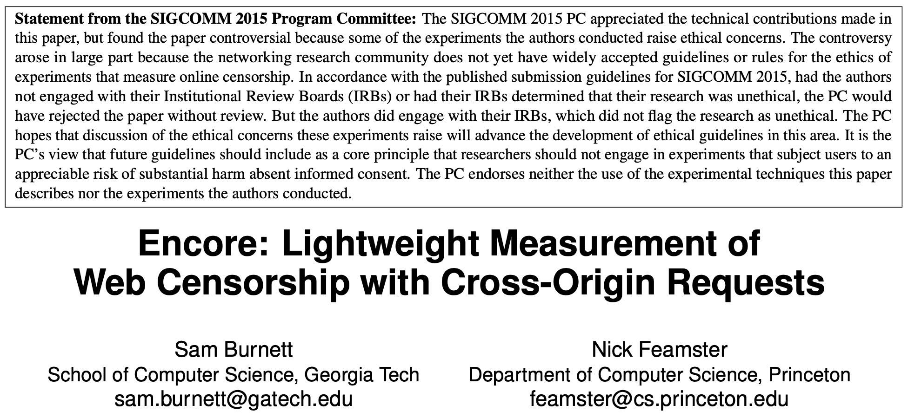
Paper from SigComm’15

Slide 65
Quote from the “Encore” paper
Balancing the benefit and risk of measuring filtering with Encore is difficult.
This paper has made the benefit clear: Encore enables researchers to collect new data about filtering from a diversity of vantage points that was previously prohibitively expensive to obtain and coordinate. Ongoing efforts to measure Web filtering would benefit from Encore’s diversity and systematic rigor [8, 15, 35].
The risk that Encore poses are far more nebulous: laws against accessing filtered content vary from country to country, and may be effectively unenforceable given the ease with which sites (like Encore) can request cross-origin resources without consent; there is no ground truth about the legal and safety risks posed by collecting network measurements.

Slide 66
Ongoing Struggles
How to balance benefits vs. risks??
Technologists are good at the benefits
They are experts on their technology
Taught to market their work, to show it in the best light
Usually optimistic, best-case analysis
Technologists are bad at risks
Should consider the worst-case
Even one person put in jail because of a search is already too much harm
We should think about risks with our security hat on

Slide 67
Ongoing Struggles
How do we incentivize lower utility?
There is ~always a way to do things safely (e.g., differential privacy)
But safety reduces utility
If I only had __________ then I could solve __________ !
We need to break the desire for splashy headlines
The adversary knows no ethical bounds
Will they always have the upper hand?

Slide 68
Departing Advice
Think carefully about safety during research design
There will be clear choices, and not so clear choices
Seek advice from colleagues
Seek advice from experts when possible
If still unsure, be conservative or choose a different problem

